Slide 1

Project on National Data Portals in Samoa and Fiji Workshop 2 Experience Sharing and SDMX/.Stat Suite Tools 27-31 January 2025 Suva, Fiji
FMR Workbench: Concepts and Codelists

Slide 2


Learning objectives
At the end of this session, you will be able to use the Fusion Metadata Registry workbench to:
Create, edit, and delete Concept Schemes and Codelists

Slide 3
Outline
Concepts
Create through Wizard
Edit
Delete
Codelists
Create through Wizard
Edit
Delete

Slide 4
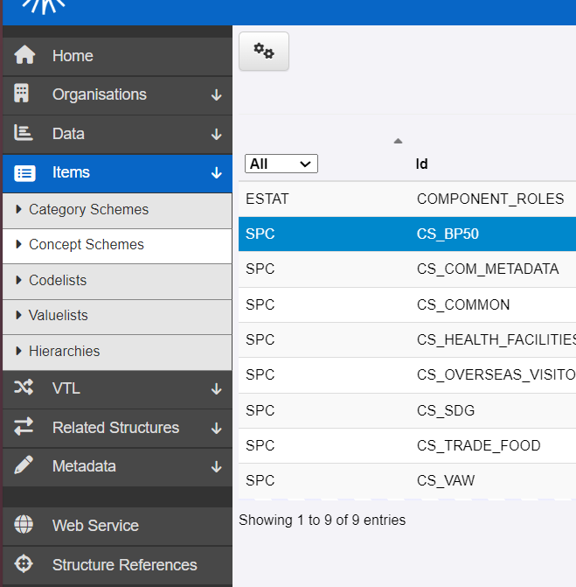
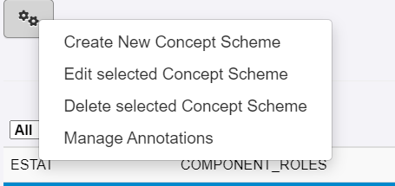
Concept: Wizard
FWB gives us options to manage Concept Schemes:
Create
Edit
Delete
Annotate (we’ll see this in another session)

Slide 5
Concept: Wizard
FWB gives us options to manage Concept Schemes:
Create
Edit
Delete
Annotate (we’ll see this in another session)

Slide 6
Concept: Wizard
A wizard for Concept Creation
4 steps (and a bunch of options)

Slide 7
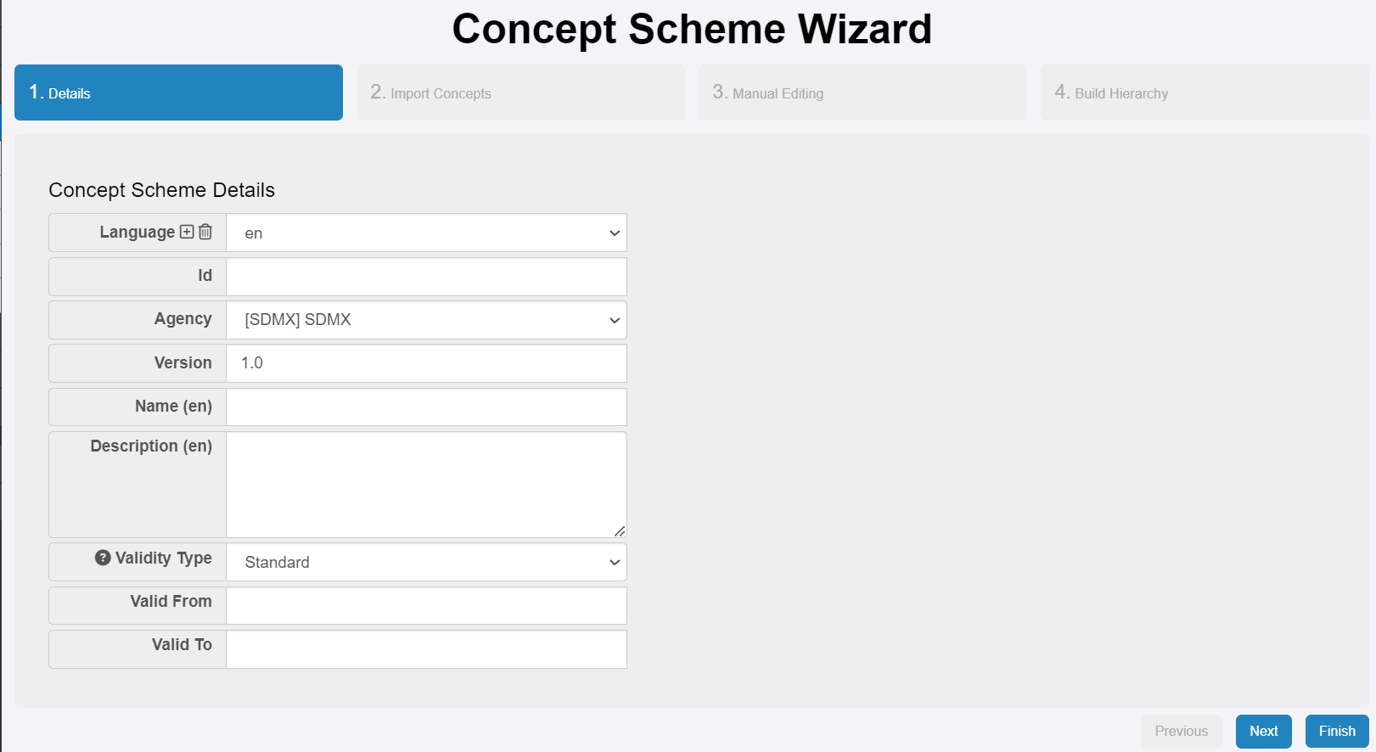
Concept: Wizard
Details
Id, Name, and Description are mandatory and important!
Multilingual is possible.
Careful with Agency.

Slide 8
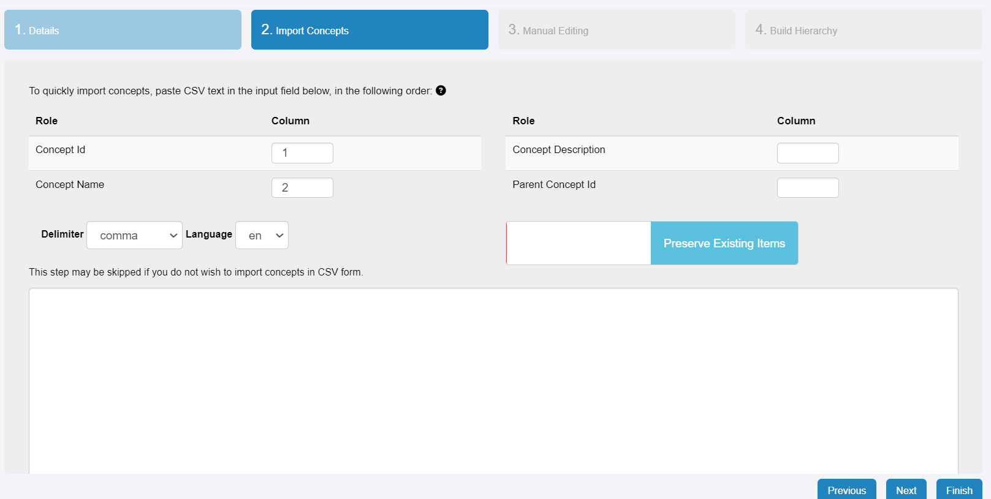
Concept: Wizard
Details
import csv (optional)

Slide 9
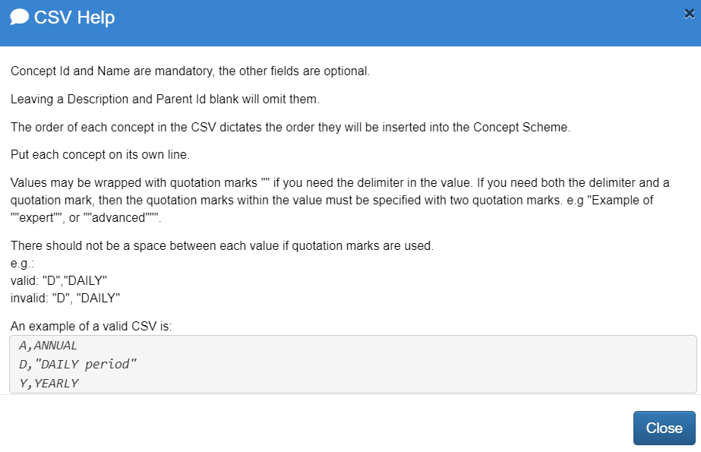
Concept: Wizard
Details
import csv (optional)

Slide 10
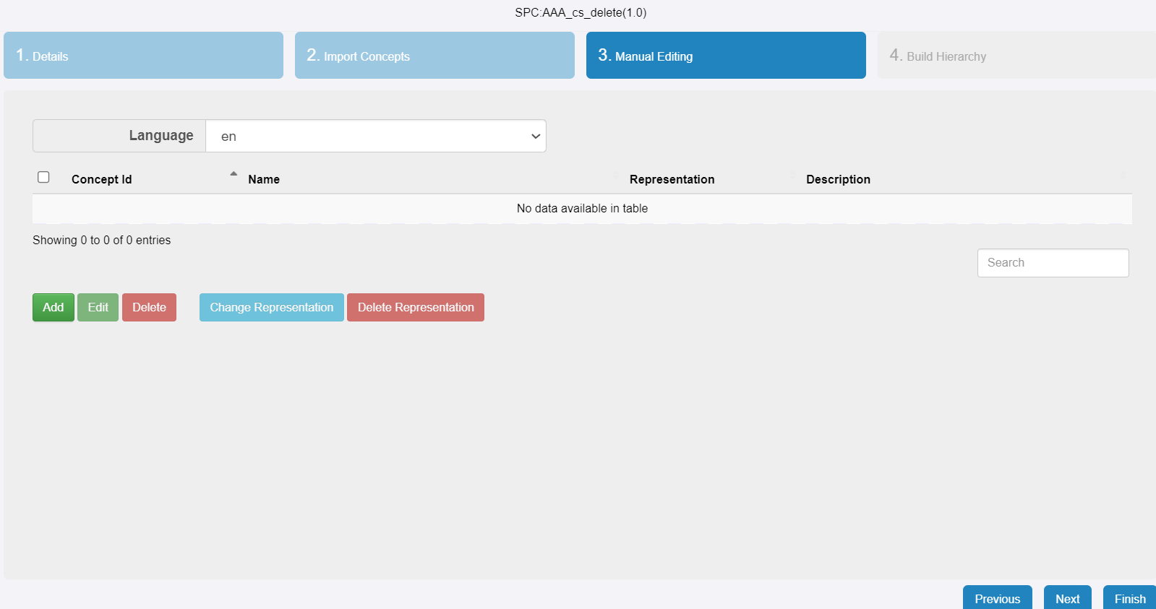
Concept: Wizard
Details
import csv (optional)
Add concepts

Slide 11
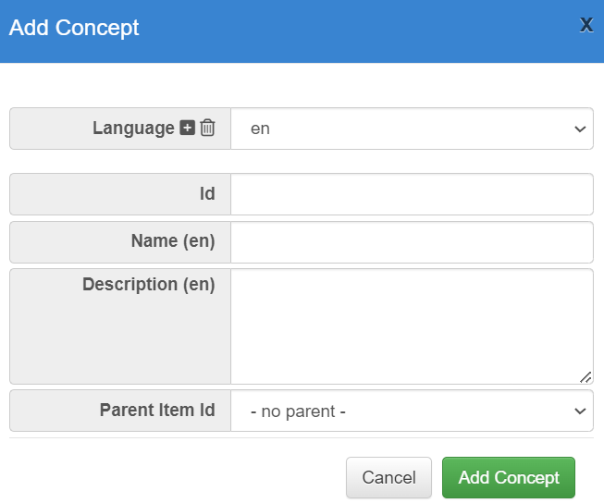


Concept: Wizard
Details
import csv (optional)
Add concepts

Slide 12
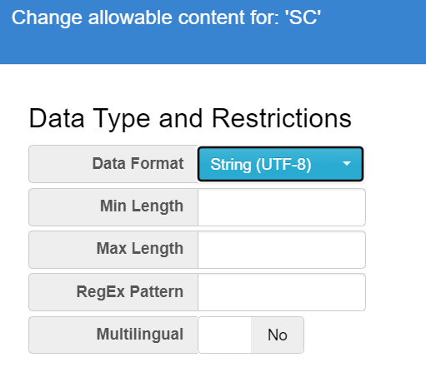

Concept: Wizard
Details
import csv (optional)
Add concepts
Define Type and Restrictions

Slide 13
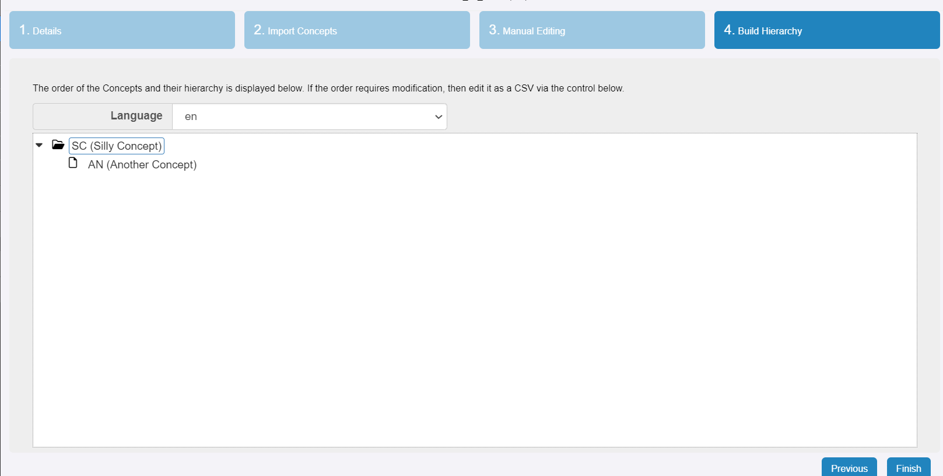
Concept: Wizard
Details
import csv (optional)
Add concepts
Build concept hierarchy (optional)

Slide 14
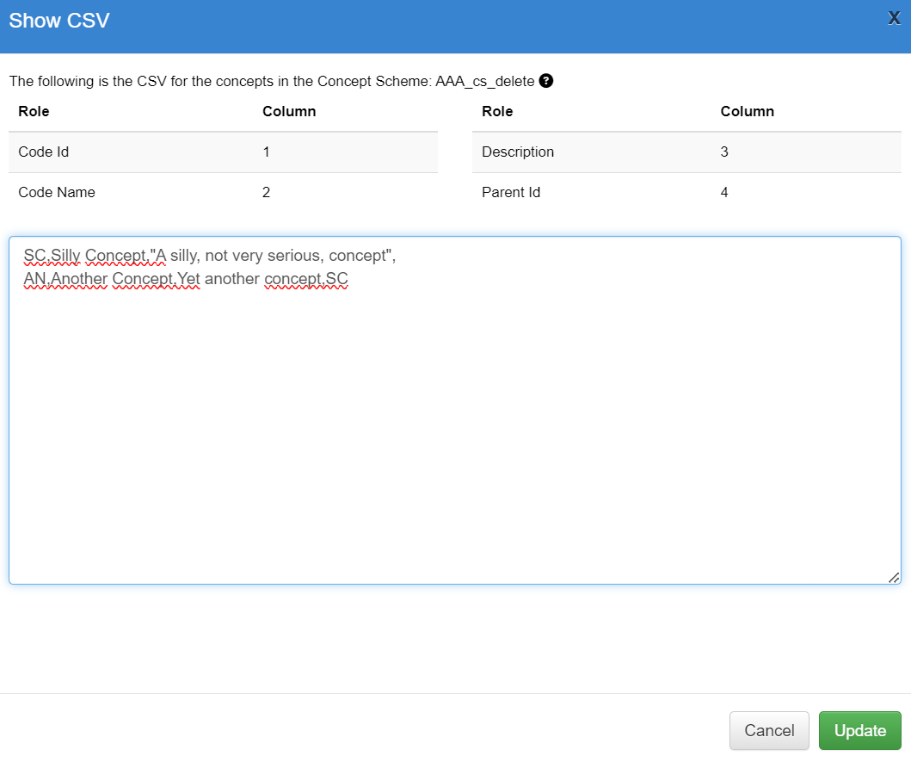
Concept: Wizard
Details
import csv (optional)
Add concepts
Build concept hierarchy (optional) csv import is also possible

Slide 15
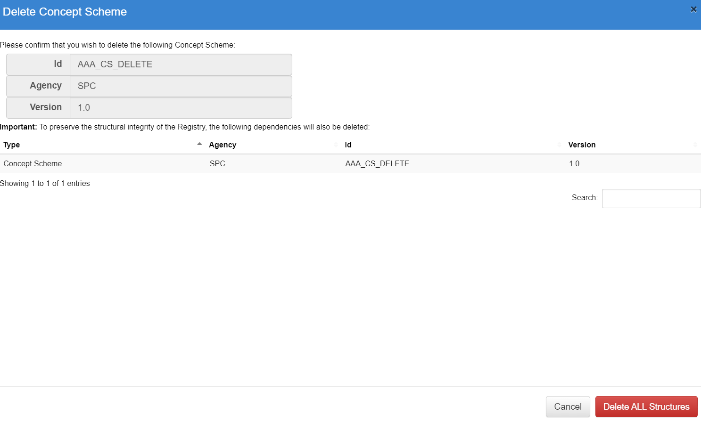

Concept: Delete
We can delete concepts. Other structures might depend on them. If you want to delete a structure with dependencies, you need to also be ready to delete those (and to recreate them!)

Slide 16
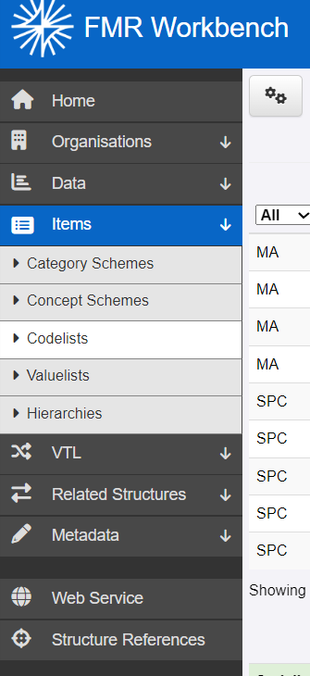
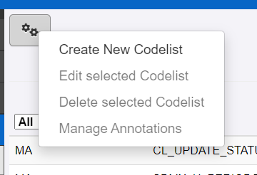
Codelist: Wizard
FWB gives us options to manage Codelists:
Create
Edit
Delete
Annotate (we’ll see this in another session)

Slide 17
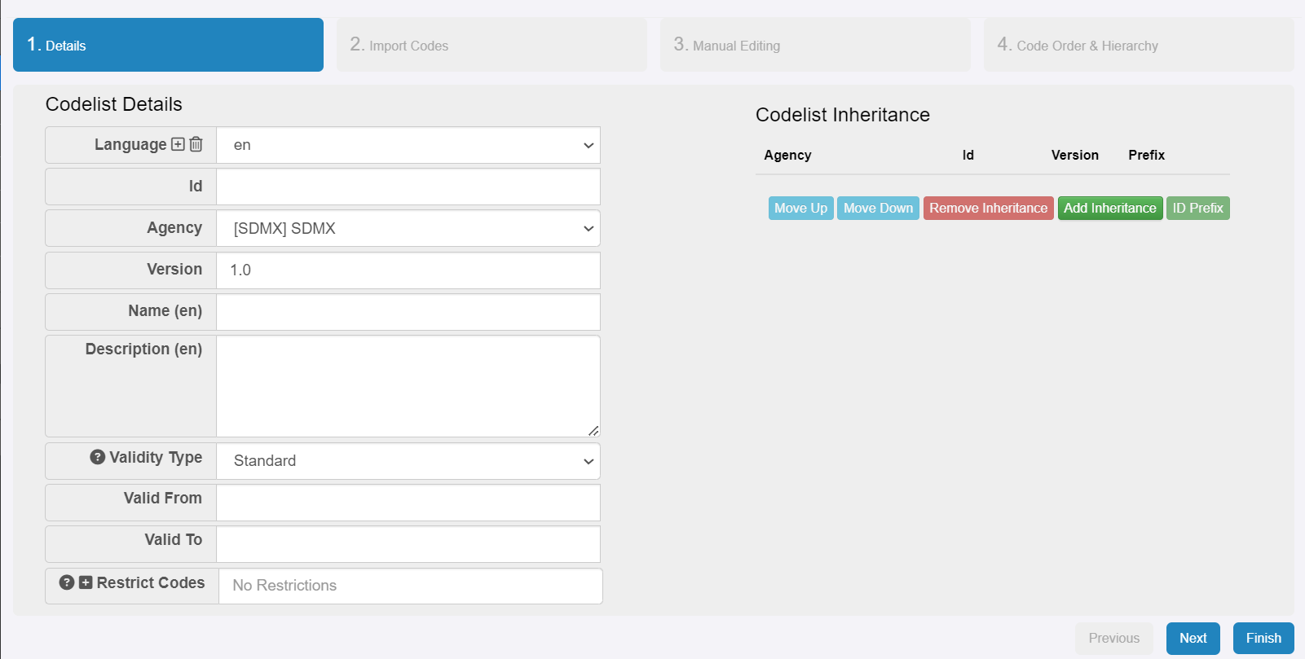
Codelist: Wizard
Details
Id, Name, and Description are mandatory and important!
Multilingual is possible.
Careful with Agency.

Slide 18
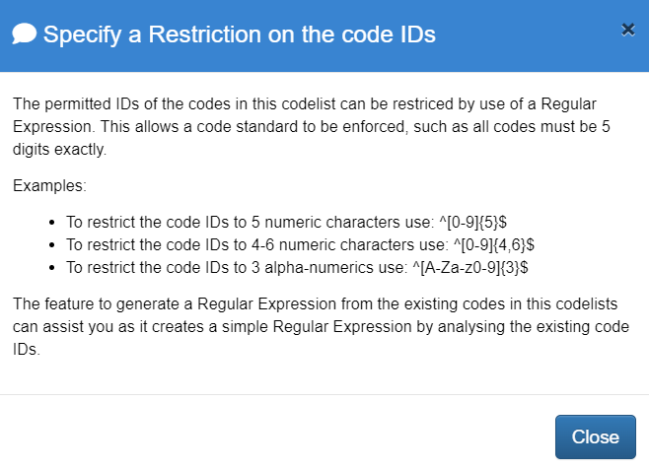
Codelist: Wizard
Details
Optional:
Restrict possible codes

Slide 19
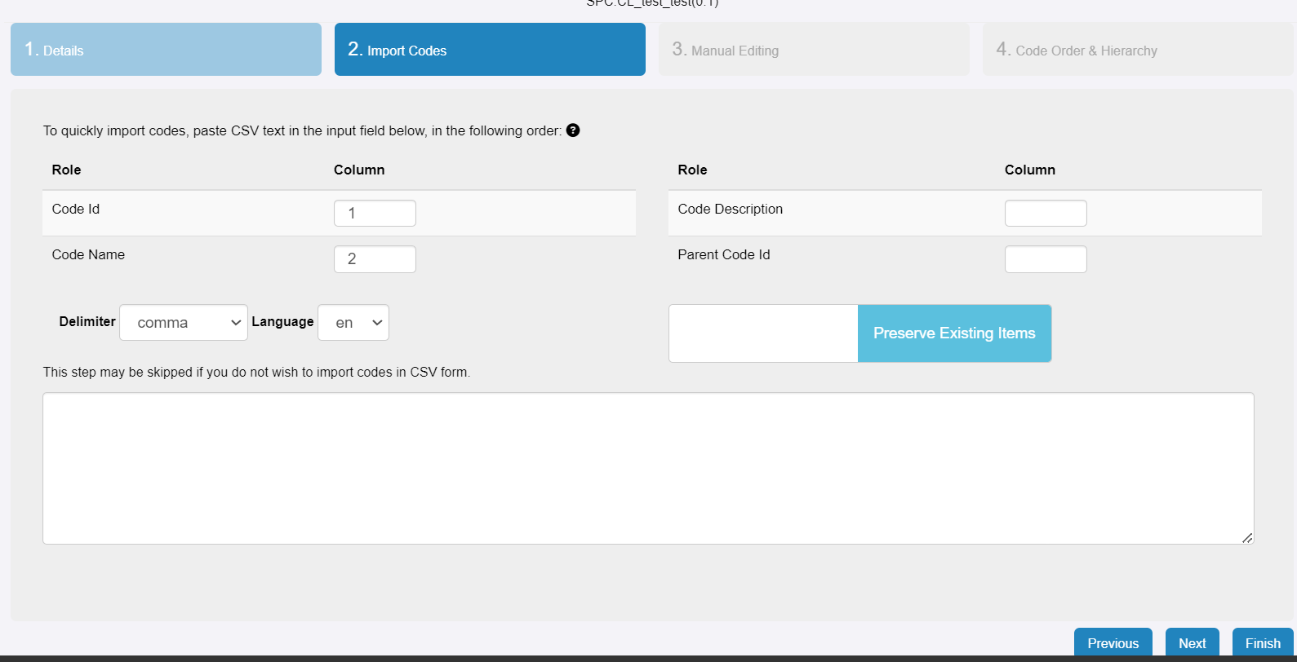
Codelist: Wizard
Details
Import from csv (optional)

Slide 20
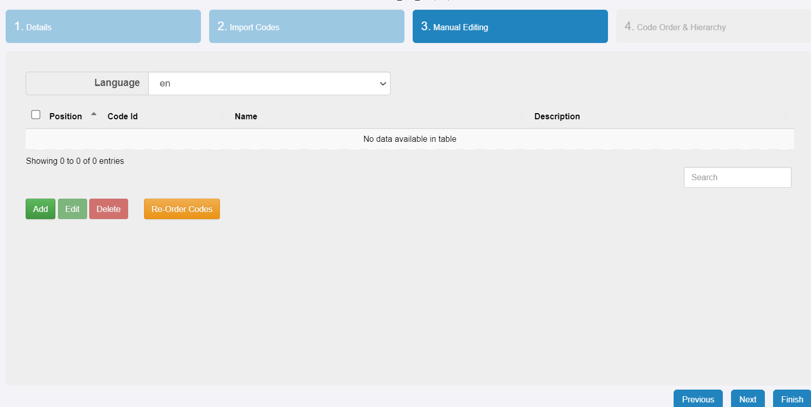
Codelist: Wizard
Details
Import from csv (optional)
Add codes

Slide 21
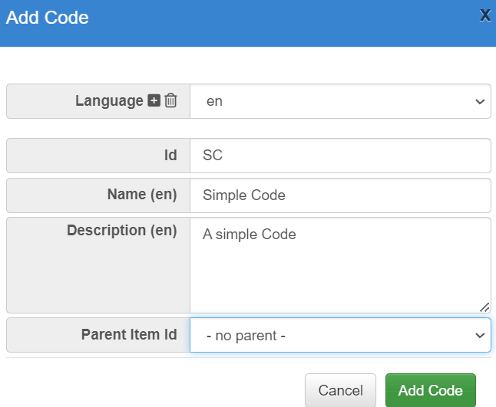
Codelist: Wizard
Details
Import from csv (optional)
Add codes
Hierarchies can be defined through specifying parents (hence, define wider concepts first: first “Pizza”, then “Hawaiian Pizza”)

Slide 22
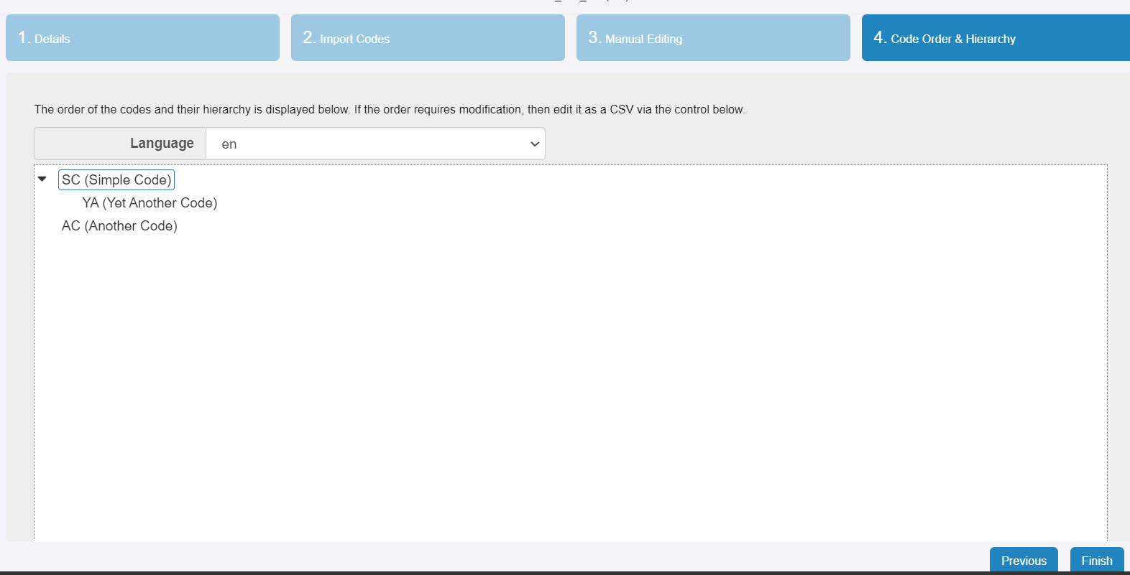
Codelist: Wizard
Details
Import from csv (optional)
Add codes
Hierarchies can be defined through specifying parents
Check order and hierarchy

Slide 23
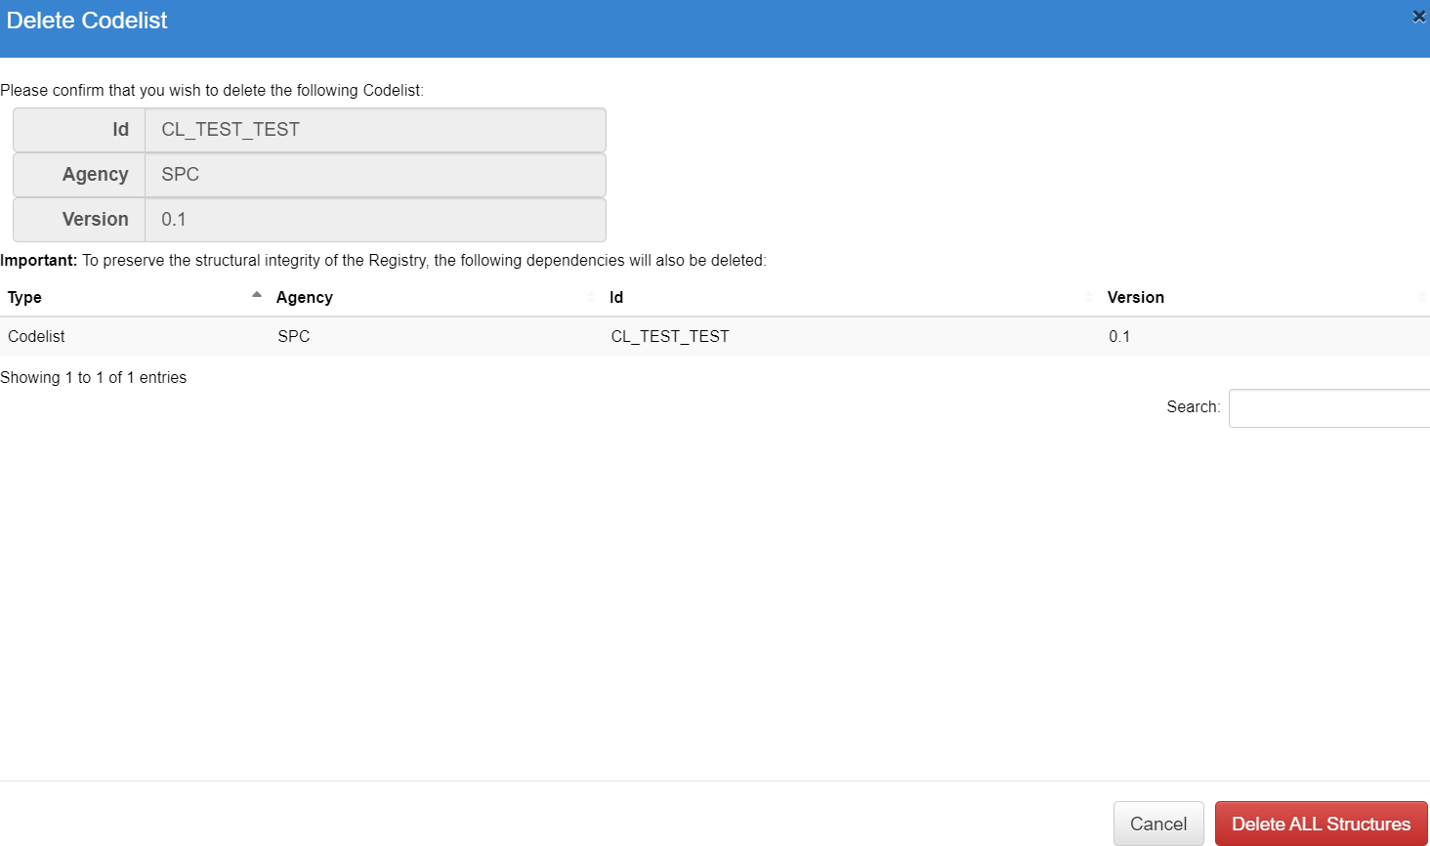
Codelist: Delete
We can delete codelists. Other structures might depend on them. If you want to delete a structure with dependencies, you need to also be ready to delete those (and to recreate them!)

Slide 24
Exercise
Consider Fiji and Samoa published population data (for example: Fiji, Samoa)
Identify and create some concepts and codelists needed to recreate those tables.
Validate each other artefacts, or edit them otherwise.
Consider: can any artefact created by others be reused?

Slide 25
Discussion and Q&A

